Slide 1
Smart Home Intercom System
Prepared for:
D. Kevin McGrath
Prepared by:
Glen Anderson
Jordan Davis
Lazar Sharipoff

Slide 2
Purpose:
Replace old fashioned paging systems
Remove the need to shout throughout the house
Ability to page a specific node
Ability to identify rooms with a person in them and page to these rooms
Ability to have a video conversation in separate rooms

Slide 3
Requirements:
Place call from one node to another
Call can stream audio and video
Secure
Audio and video encrypted
No audio or video data is stored, only streamed
No connection to external network
Different user modes with varying levels of access
Ability to detect a person in a room
Reasonably easy setup, minimal configuration
Low per unit cost
~$200.00

Slide 4
Stumbling blocks
Scheduling difficulties
To overcome scheduling difficulties, establish consistent meeting times and cancel as far ahead in advance as possible (if needed)
In part because client is also our instructor, there were very few stumbles

Slide 5
Systems:
Hardware
Operating System
Software
Screen
Data Storage
Audio I/O
Networking
IR Camera
Encryption
Raspberry Pi 3
Person Detection

Slide 6
Hardware:
Raspberry Pi 3
Touchscreen
Case
Audio I/O
IR Camera

Slide 7
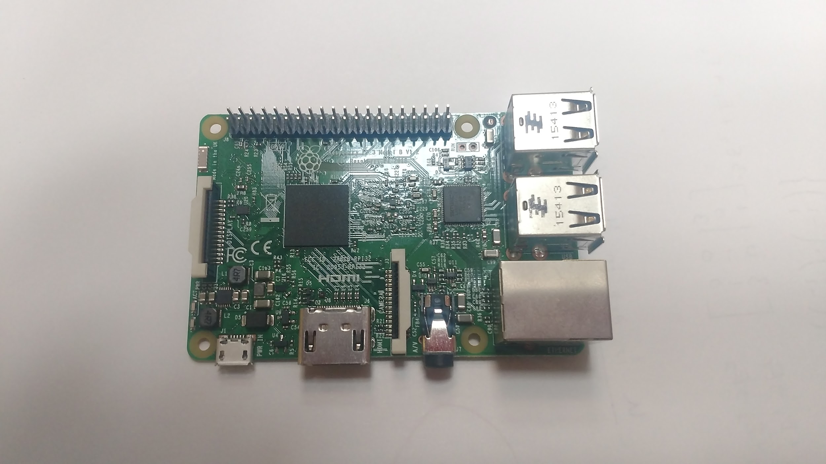
Raspberry Pi 3
Small single board computer
Fits within budget
Can be deployed with software package pre-installed
Can support multiple sensors and pieces of hardware
Has a large amount of community support

Slide 8
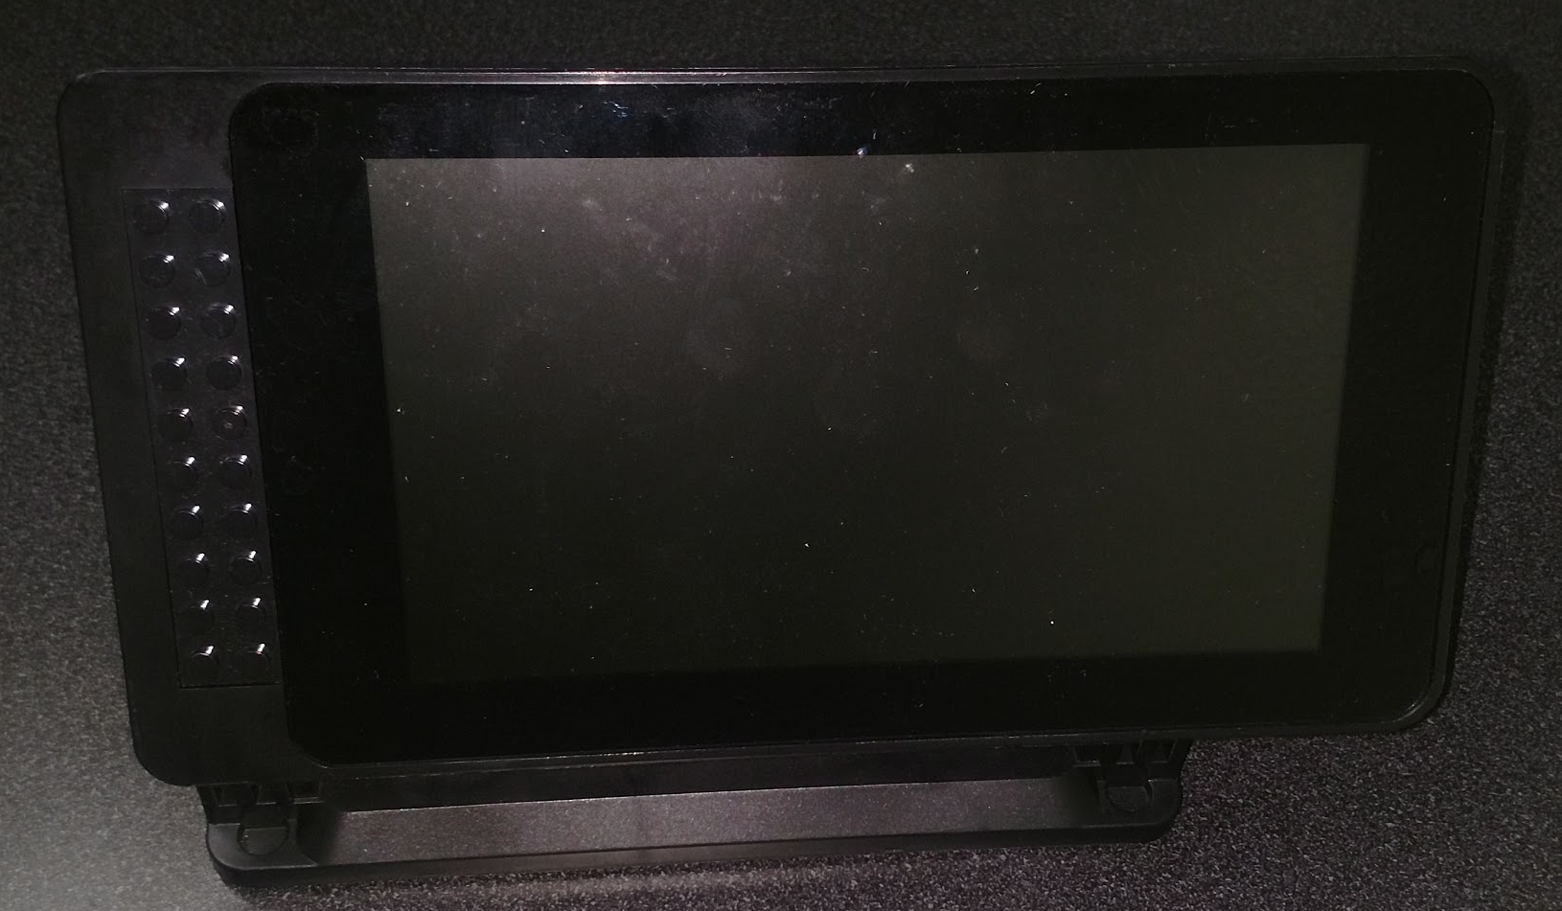
Touchscreen
7” Screen
Size and Resolution
Cost

Slide 9
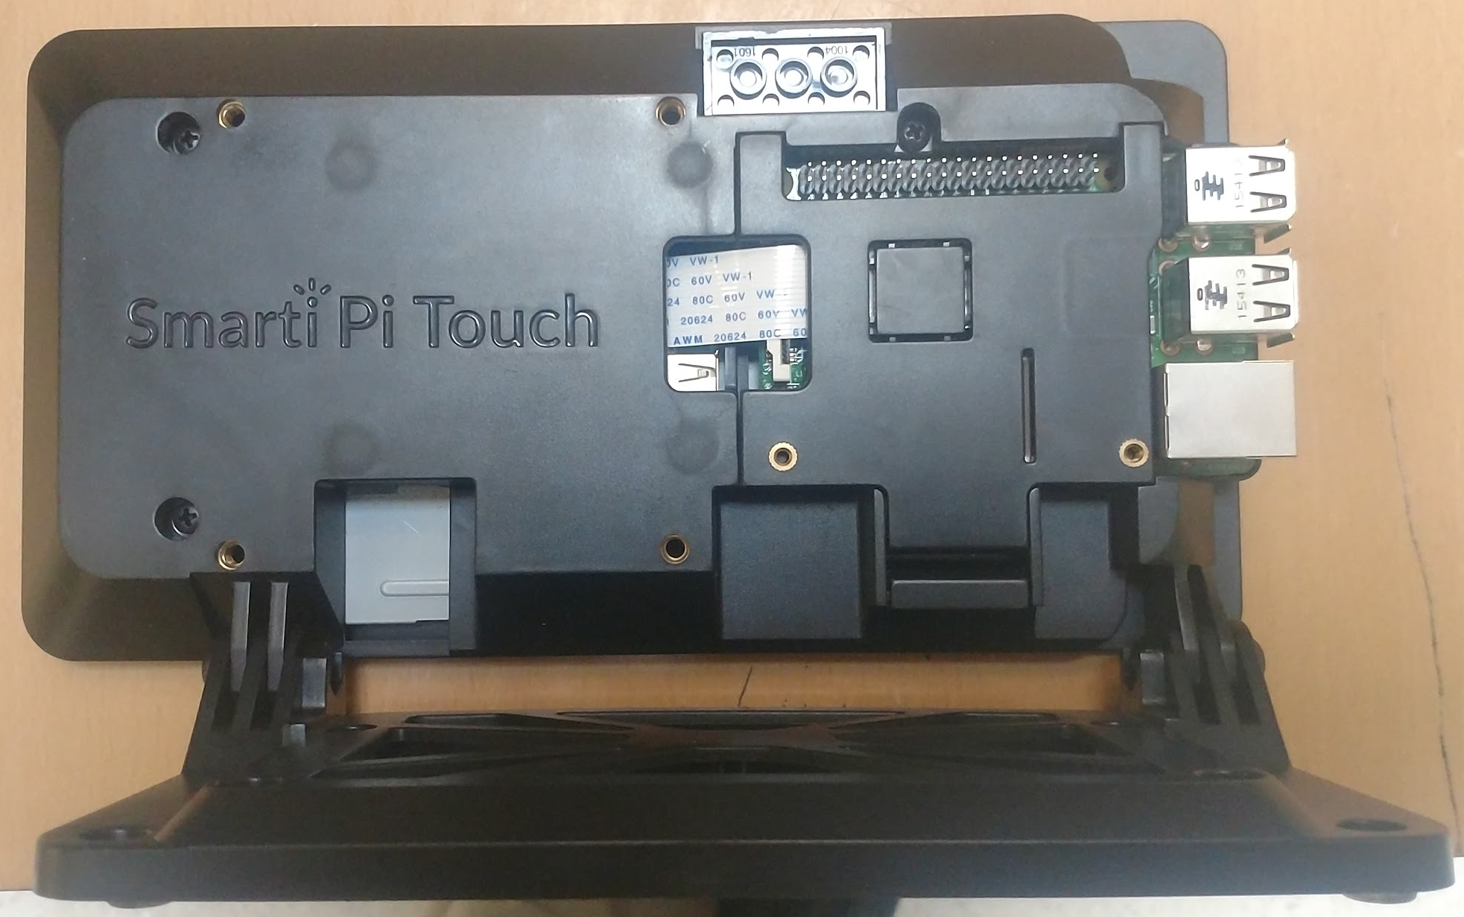
Case
Case
Can house a 7” touch screen
Can be mounted on wall
Keeps USB ports of Pi open
Can have camera mounted to it easily
Supports expansion
GPIO pins for hats
Punch out hole for heatsink

Slide 10
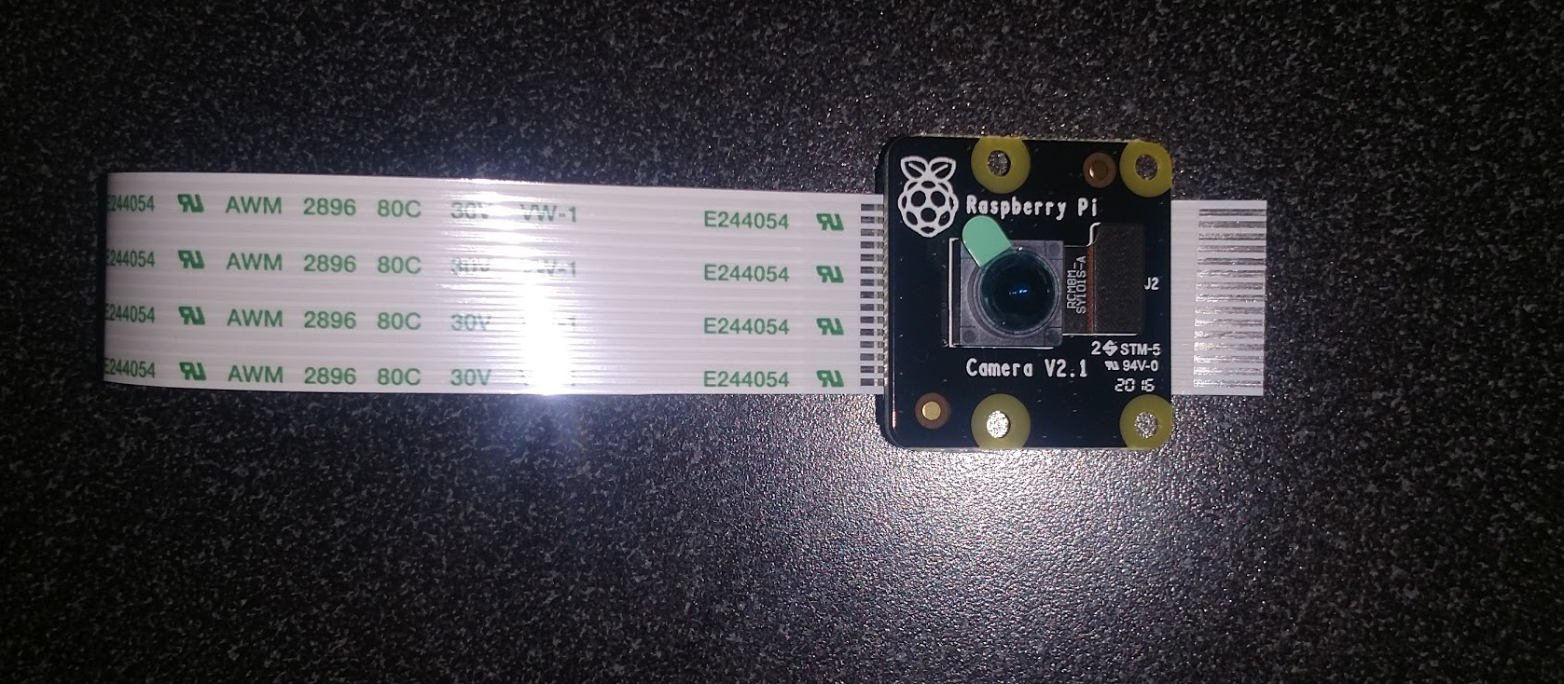
Camera
NoIR Camera
Will be upgraded to IR
Used for video stream input
Used for person detection

Slide 11
Audio I/O
HiFiBerry sound card for audio output
Higher quality than built in sound card
Widely available
Sparkfun microphone or USB microphone for audio input
USB microphone would require no hardware configuration but would allow for less flexibility
Sparkfun microphone would have to be installed, but would allow for flexibility with the design of each node
VideoLAN media player to stream audio between nodes
Compatible with the platform

Slide 12
Operating System
OS will be implemented using Raspbian Stretch
Two options available, Stretch and Stretch Lite
Stretch Lite is implemented without a GUI
Stretch has GUI but is approximately 1.25GB larger
Ultimately as a proof of concept, Stretch will have greater support of systems.

Slide 13
Software:
Network Modules
Network Encryption
Person Detection
Data Management
Video Streaming Software
User Interface

Slide 14
Network Modules
Qt 5.0 Network Module
Examples online to test implementation
Encapsulates application data
Better Approach to Mobile AdHoc Networking (B.A.T.M.A.N.)
Batman-adv is a well documented implementation
Layer 2 implementation
Will create its own mesh network for talking between nodes

Slide 15
Network Encryption
Salsa20
Ability to encrypt audio and video as it streams
Variable encryption speed with different versions of Salsa20
Available in multiple libraries

Slide 16
Person Detection
IR-capable camera
Use for initial detection of a person entering a room to bring the system out of sleep mode
Facial recognition
Use OpenCV library for facial recognition
Used to verify that the IR system detected an actual person
Log that a person is in the room so that other devices can use this information when suggesting which room to call

Slide 17
Data Management
Flat file system for storing data
Store which room last had a person in it
Log detailed errors for troubleshooting purposes
Need to reliably check which rooms had a person in them
Files will be read directly from related programs, which will be activated when the system powers on

Slide 18
Video Streaming Software
VLC
Capture Rate
Can be set to the max capture rate of the installed camera
Hardware Compatibility
Bandwidth
Can stream audio
Installation

Slide 19
User Interface:
Implemented using Qt 5.0
Will boot using embedded mode straight into the program
Will first be implemented as a baseline to test network connectivity and video capture
Ultimately should be able to control brightness and contrast along with controlling camera power and swapping user modes

Slide 20
Implementation sequence
1
2
3
4
5
User Interface
Encryption
Operating System
Assembling Hardware
Networking
Video Streaming
Person Detection
Audio Streaming
Data Storage

Slide 21
Where we are
Done with majority of research, about to start implementation
Implementing individual components over the winter break:

Slide 22
Individual Goals
Over winter break:
Glen: Person detection
Jordan: Network implementation and user interface
Lazar: Encryption and video streaming
Most development will occur during winter term

Slide 23
Conclusion
Implementation will begin during winter break and continue through winter term
Documents will be updated as project progresses

